Slide 1


WILDLIFE AIRSTRIKES: A COMPREHENSIVE ANALYSIS
REPORT BY: GAURAV MEHTA
Notes:
Links:
https://www.pexels.com/photo/pie-graph-illustration-669621/

Slide 2
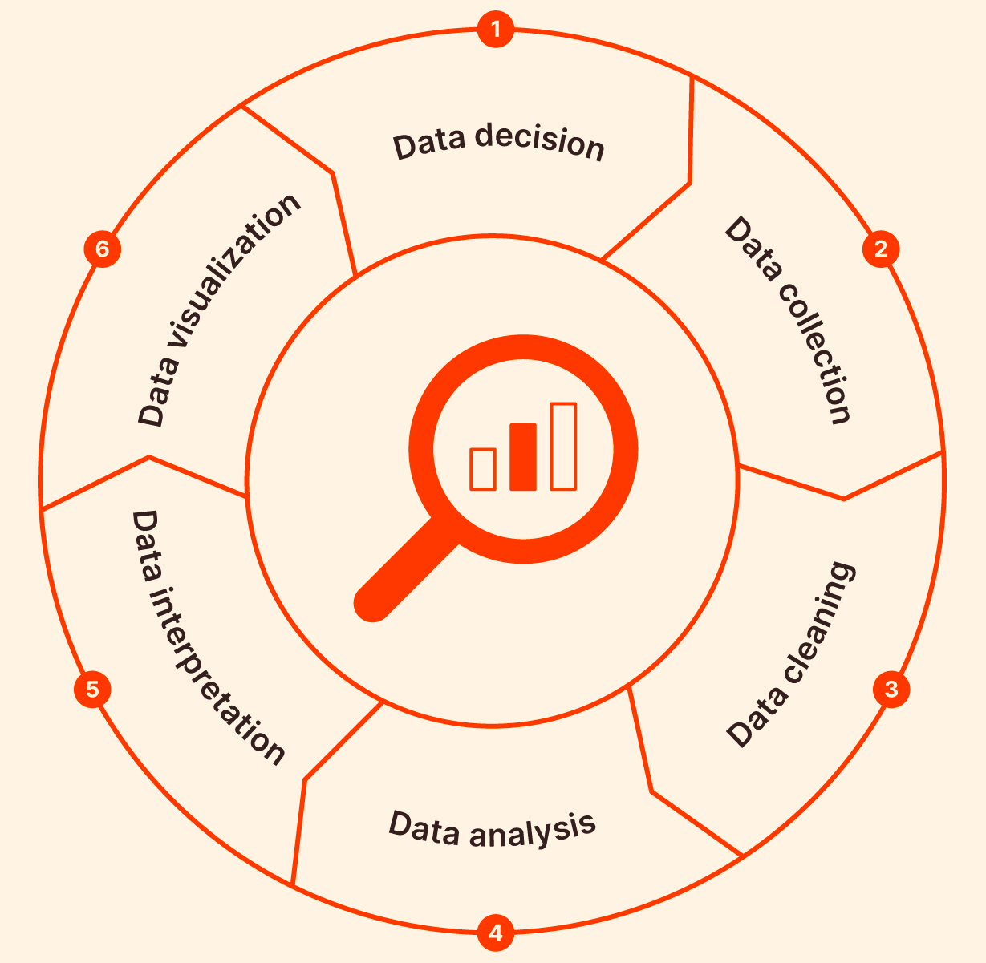
PROJECT SUMMARY
EXPLORATORY DATA ANALYSIS PROCESS
DATA DECISON
DATA ANALYSIS
Why Wildlife Airstrikes Data?
How are we going to discover useful information from the dataset?
DATA COLLECTIONS
DATA INTERPRETATION
How was the dataset retrieved?
Can the information retrieved be used to answer our FINER research questions?
DATA CLEANING
DATA VISUALIZATION
How are we going to handle so many
NULL Values?
Can the data be represented graphically post analysis?

Slide 3


DATA DECISION & ACQUISITION
DATA DECSION
DATA ACQUISTION
Why Wildlife airstrikes?
Where was the dataset acquired from?
Airstrikes caused by wildlife are a prevalent type of airstrikes in every part of the world. The USA being one of the biggest airport networks across the globe is prone to more wildlife airstrikes.
The dataset has been acquired from KAGGLE and contains data on airstrikes caused in the USA from the year 1996 to 2023. Variables include incident details, aircraft information, damage assessment, and wildlife species involved.

Slide 4
DATA CLEANING
Tool Used: HIVE using GCP Apache Hadoop Cluster
Refer to document: Hive SSH Notebook
Export Cleaned Data
Once the clean data is ready, export it a CSV file to google cloud bucket
Export the Cleaned Data
Create and Update new tables and rows
Creating new values or replacing old values with a default one for simplified analysis purpose
Create and Update
Altering Columns
Dropping the columns that will not be required for analysis purpose.
Altering Columns
Treating NULL Values
Treating NULL Values
Dealing with NULL values is most important aspect of data cleaning
Importing Dataset
Importing Dataset
The acquired dataset from KAGGLE is uploaded to Hive instance where it will be cleaned based on different parameters

Slide 5

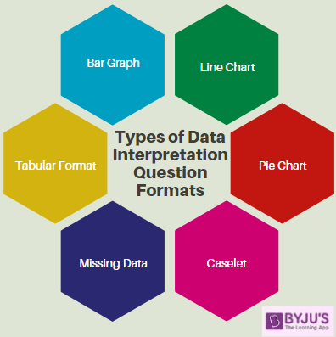
DATA ANALYSIS & INTERPRETATION
Tool Used: Jupyter Notebook in GCP
DATA ANALYSIS
DATA INTERPRETATION
The process of analyzing the data consists of structuring and modeling the data in such a way that it can be used for research purposes and be used to derive meaningful insights.
Once the data is analyzed, interpretation is the step where the research questions generated that can be used to drive important decisions can be answered.

Slide 6
Data VISUALIZATIONS

Slide 7
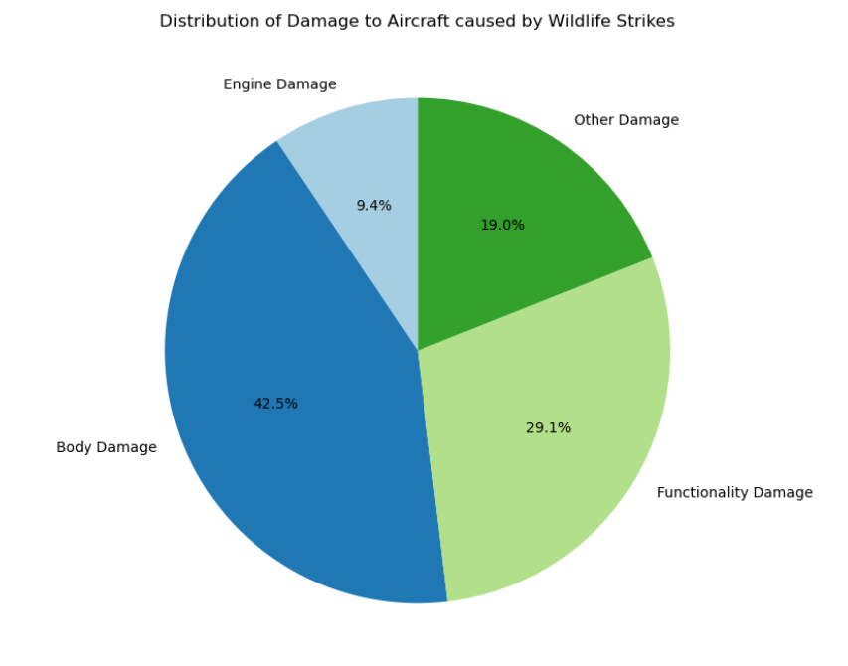
AIRCRAFT DAMAGE DISTRIBUTION
Distribution of Damage to Aircraft caused by Wildlife Strikes

Slide 8
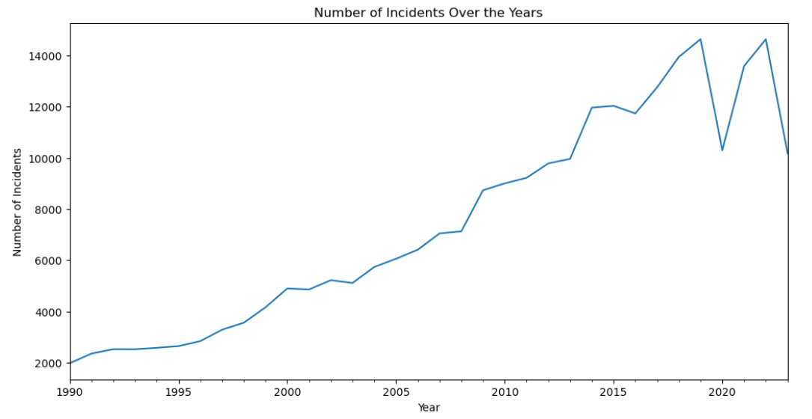
TIME SERIES ANALYSIS
Number of airstrikes over the years

Slide 9
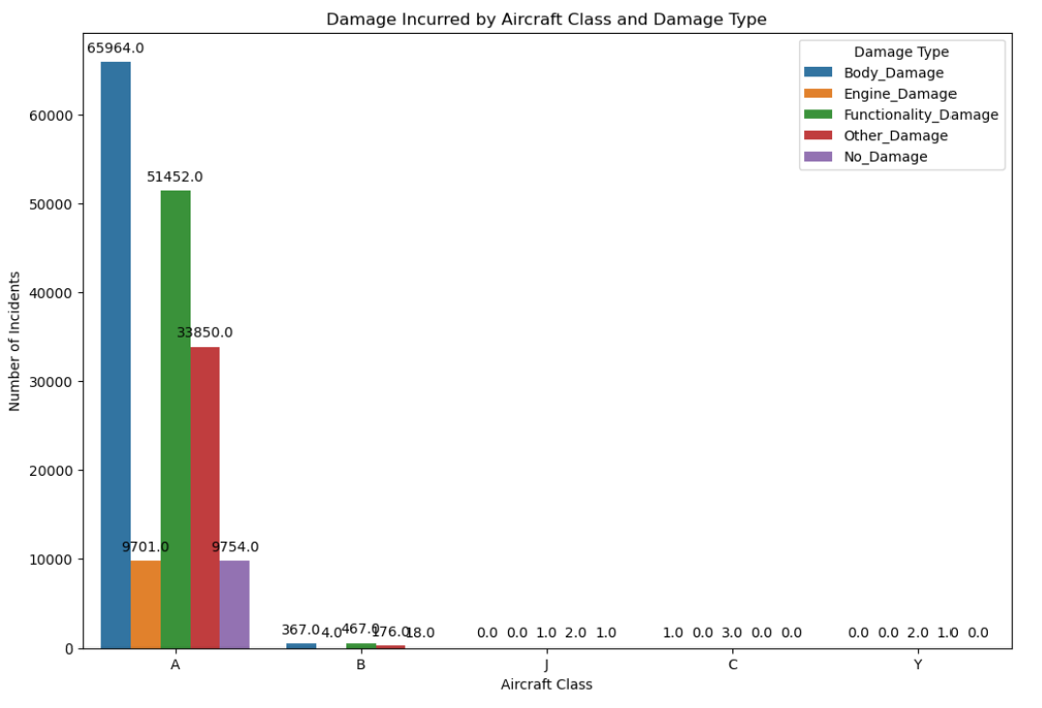
DAMAGE DISTRIBUTION ACROSS AIRCRAFT TYPES
Damage Incurred by Aircraft Class and Damage Type

Slide 10
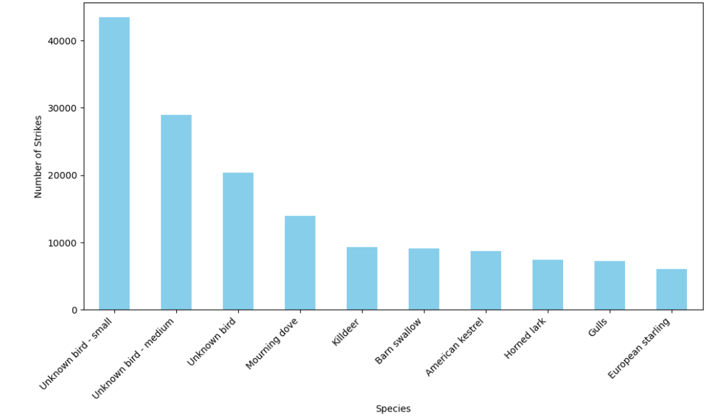
SPECIES ANALYSIS
Top Species Involved in Strikes

Slide 11
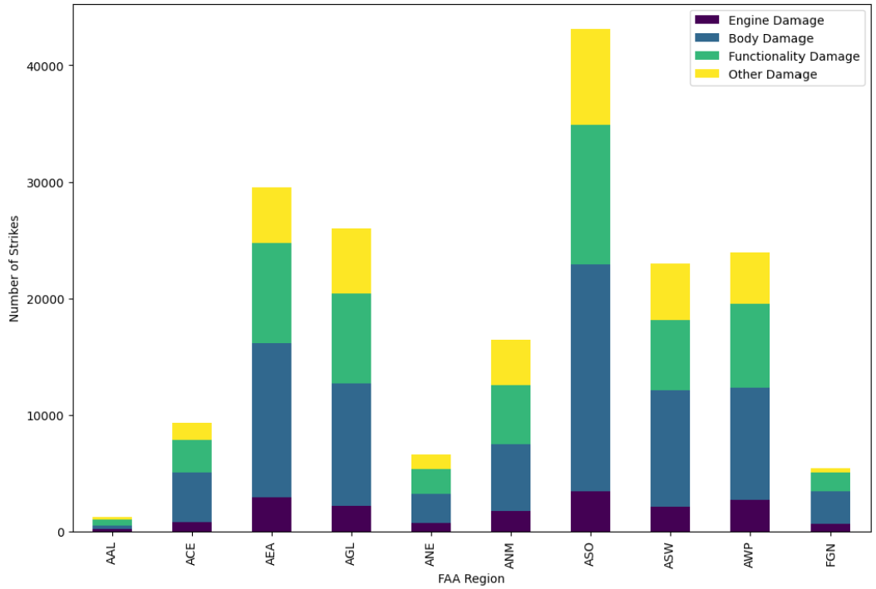
FAA REGION BASED DAMAGE DISTRIBUTION
Aircraft Damage Distribution by FAA Region

Slide 12
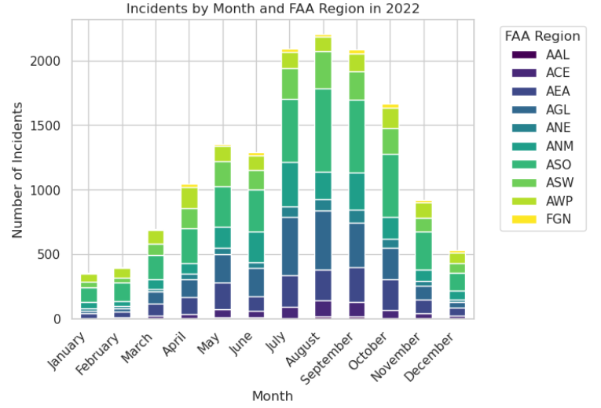
AIRCRAFT STRIKE ANALYSIS FOR THE YEAR 2022
Incidents by Month and FAA Region in 2022

Slide 13
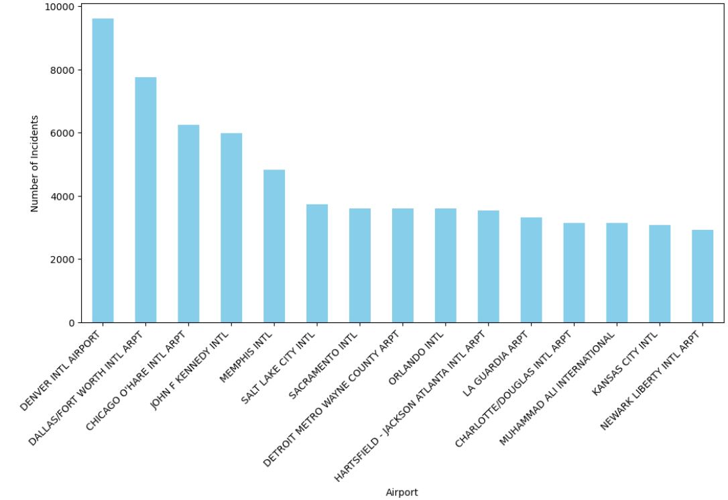
AIRSTRIKES COUNT
Top Airports Involved in Airstrikes

Slide 14
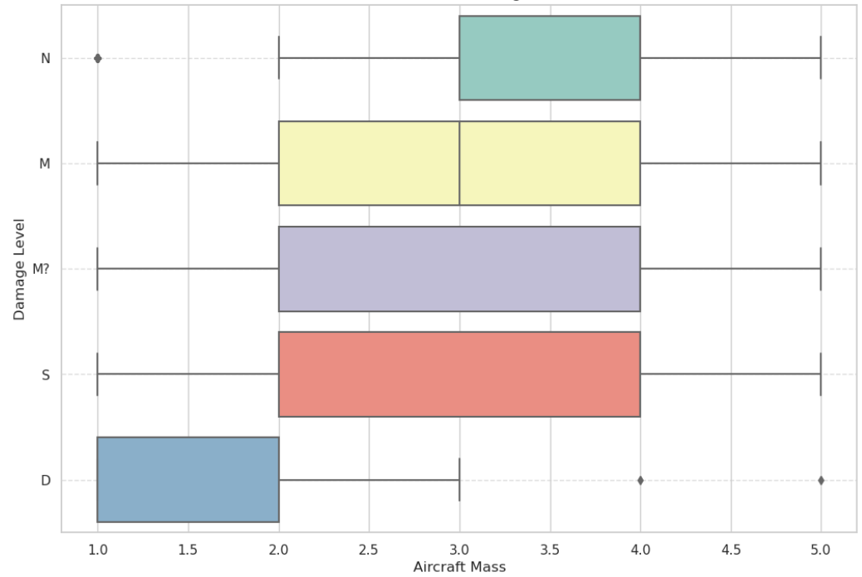
AIRCRAFT MASS ANALYSIS
Aircraft Mass vs. Damage Level

Slide 15
THANK YOU
Notes:
Links:
https://www.pexels.com/photo/pie-graph-illustration-669621/

